Slide 1
Adventure Project
Outdoor Collaboration

Slide 2
Current Products

Slide 3
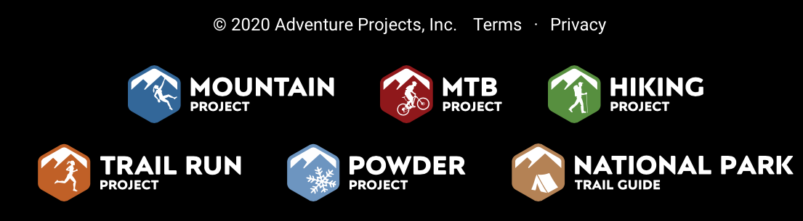
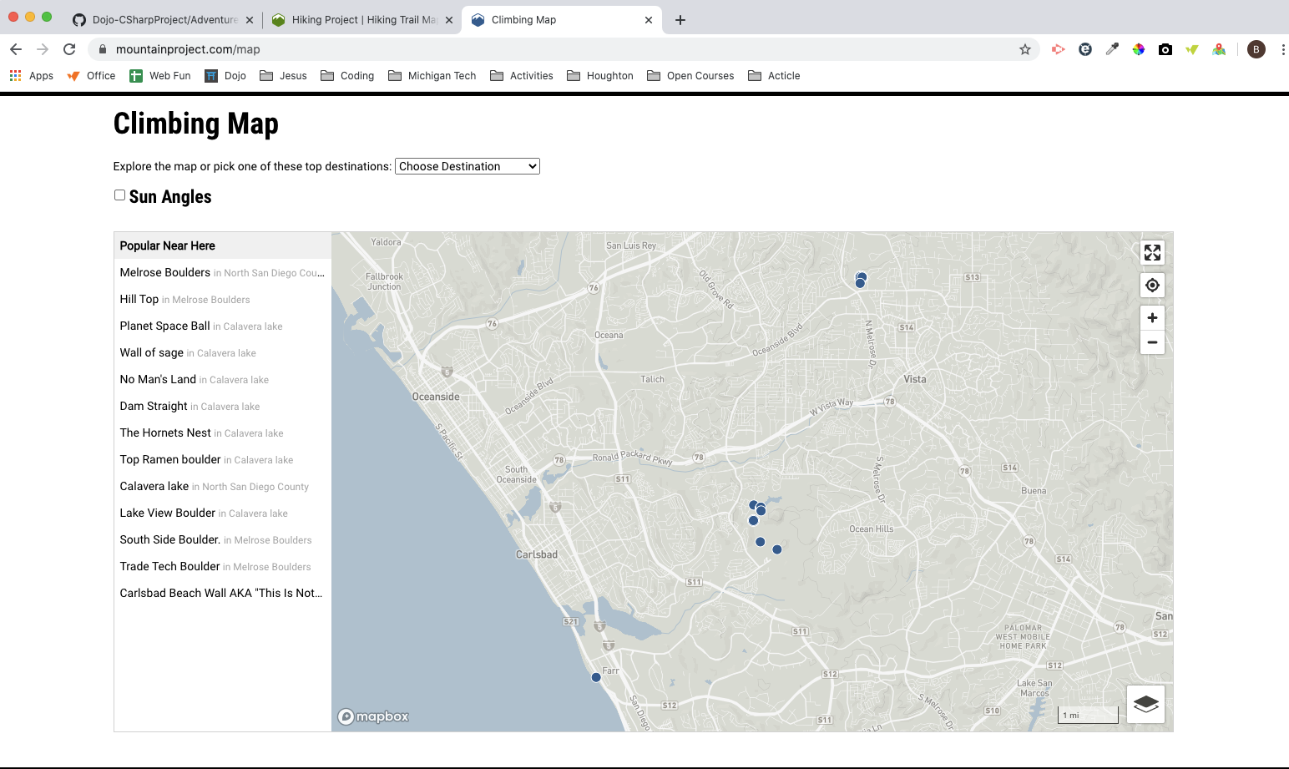


Slide 4
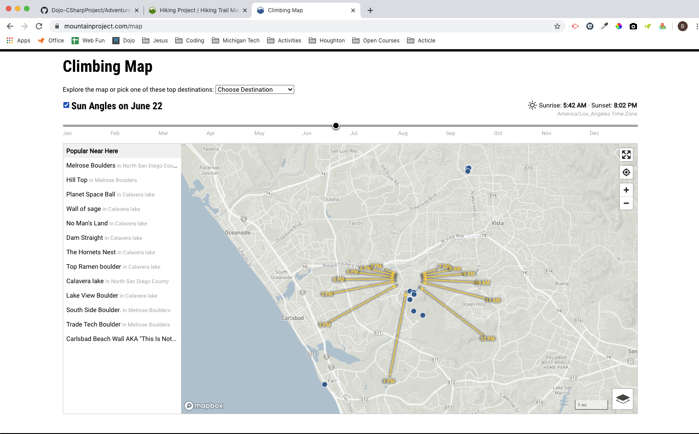

Slide 5
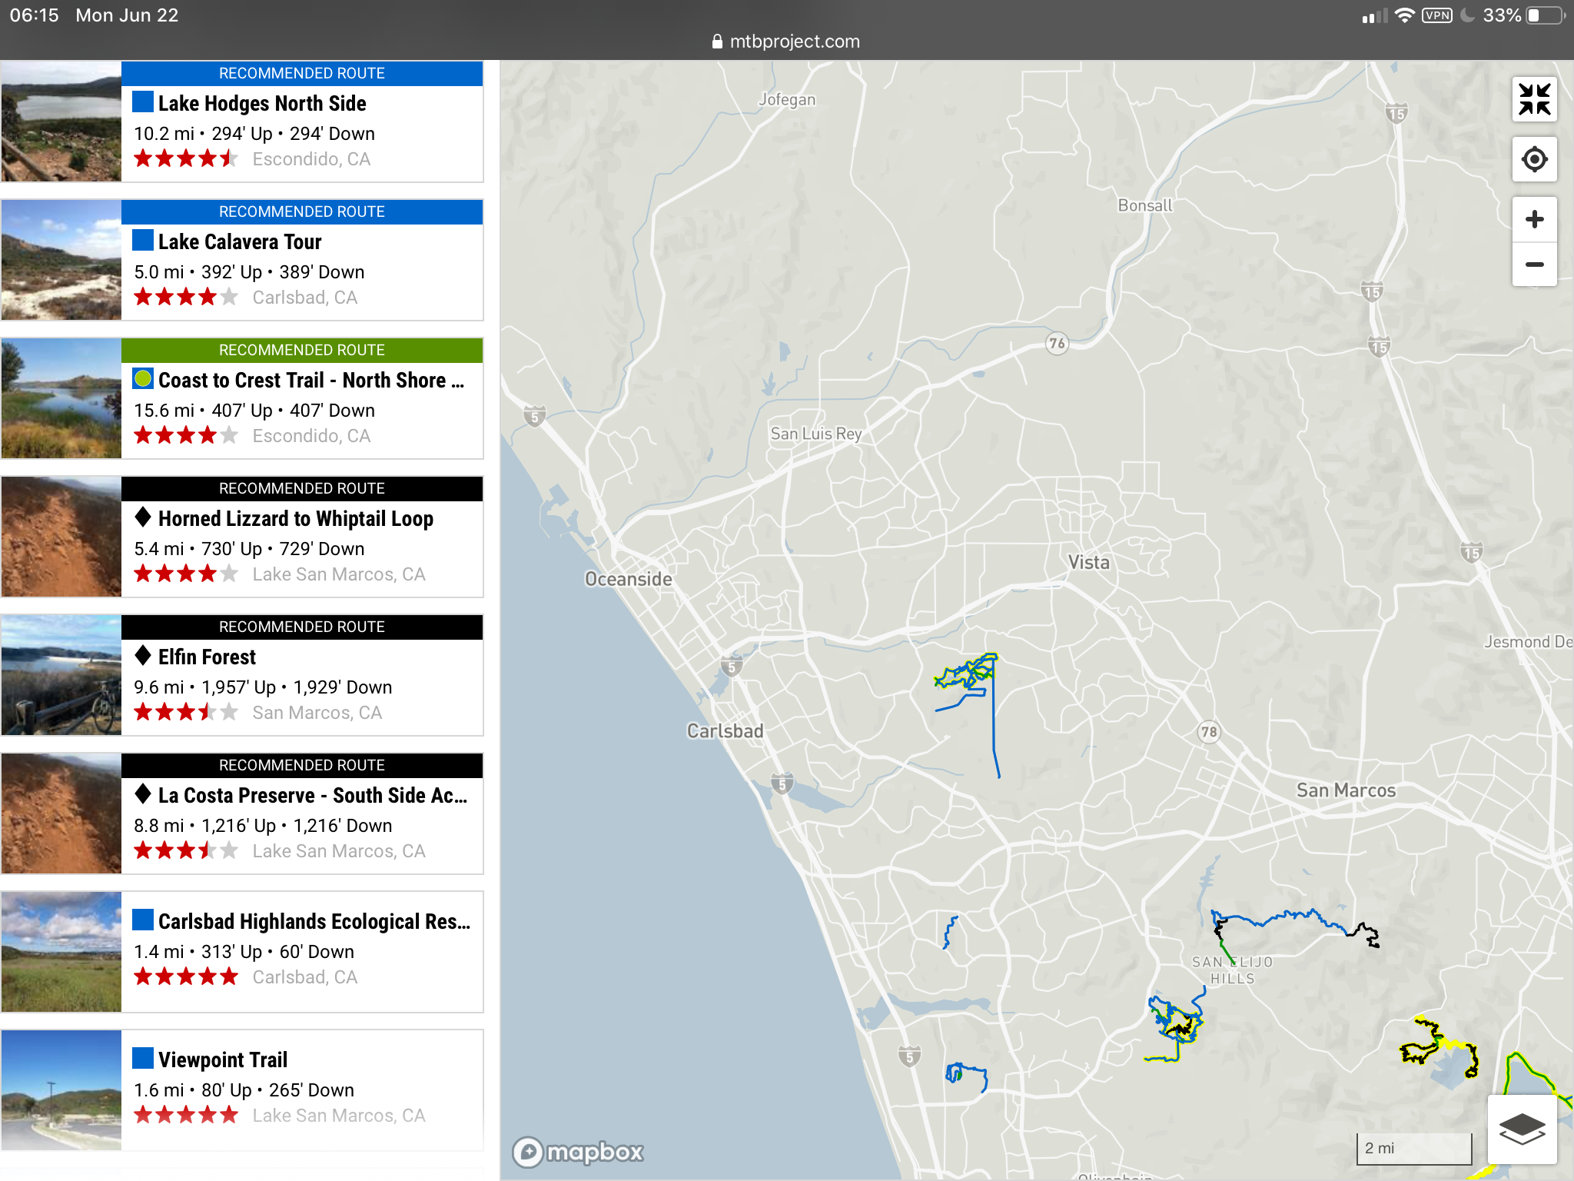


Slide 6
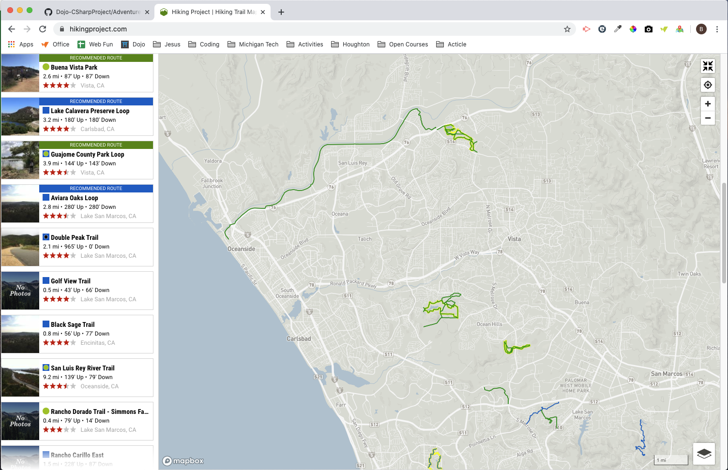


Slide 7
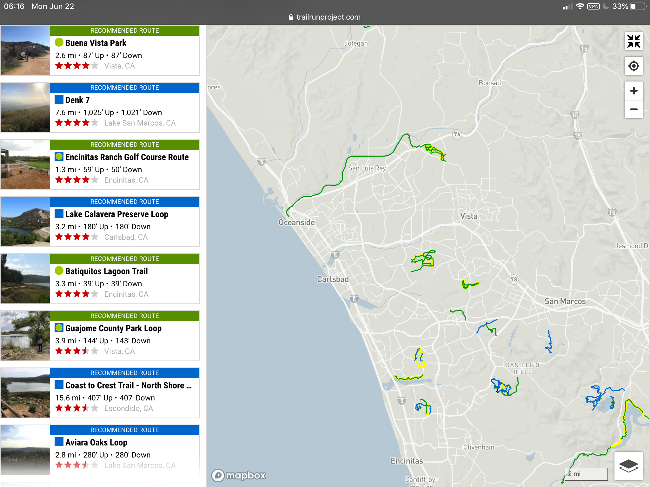

Slide 8
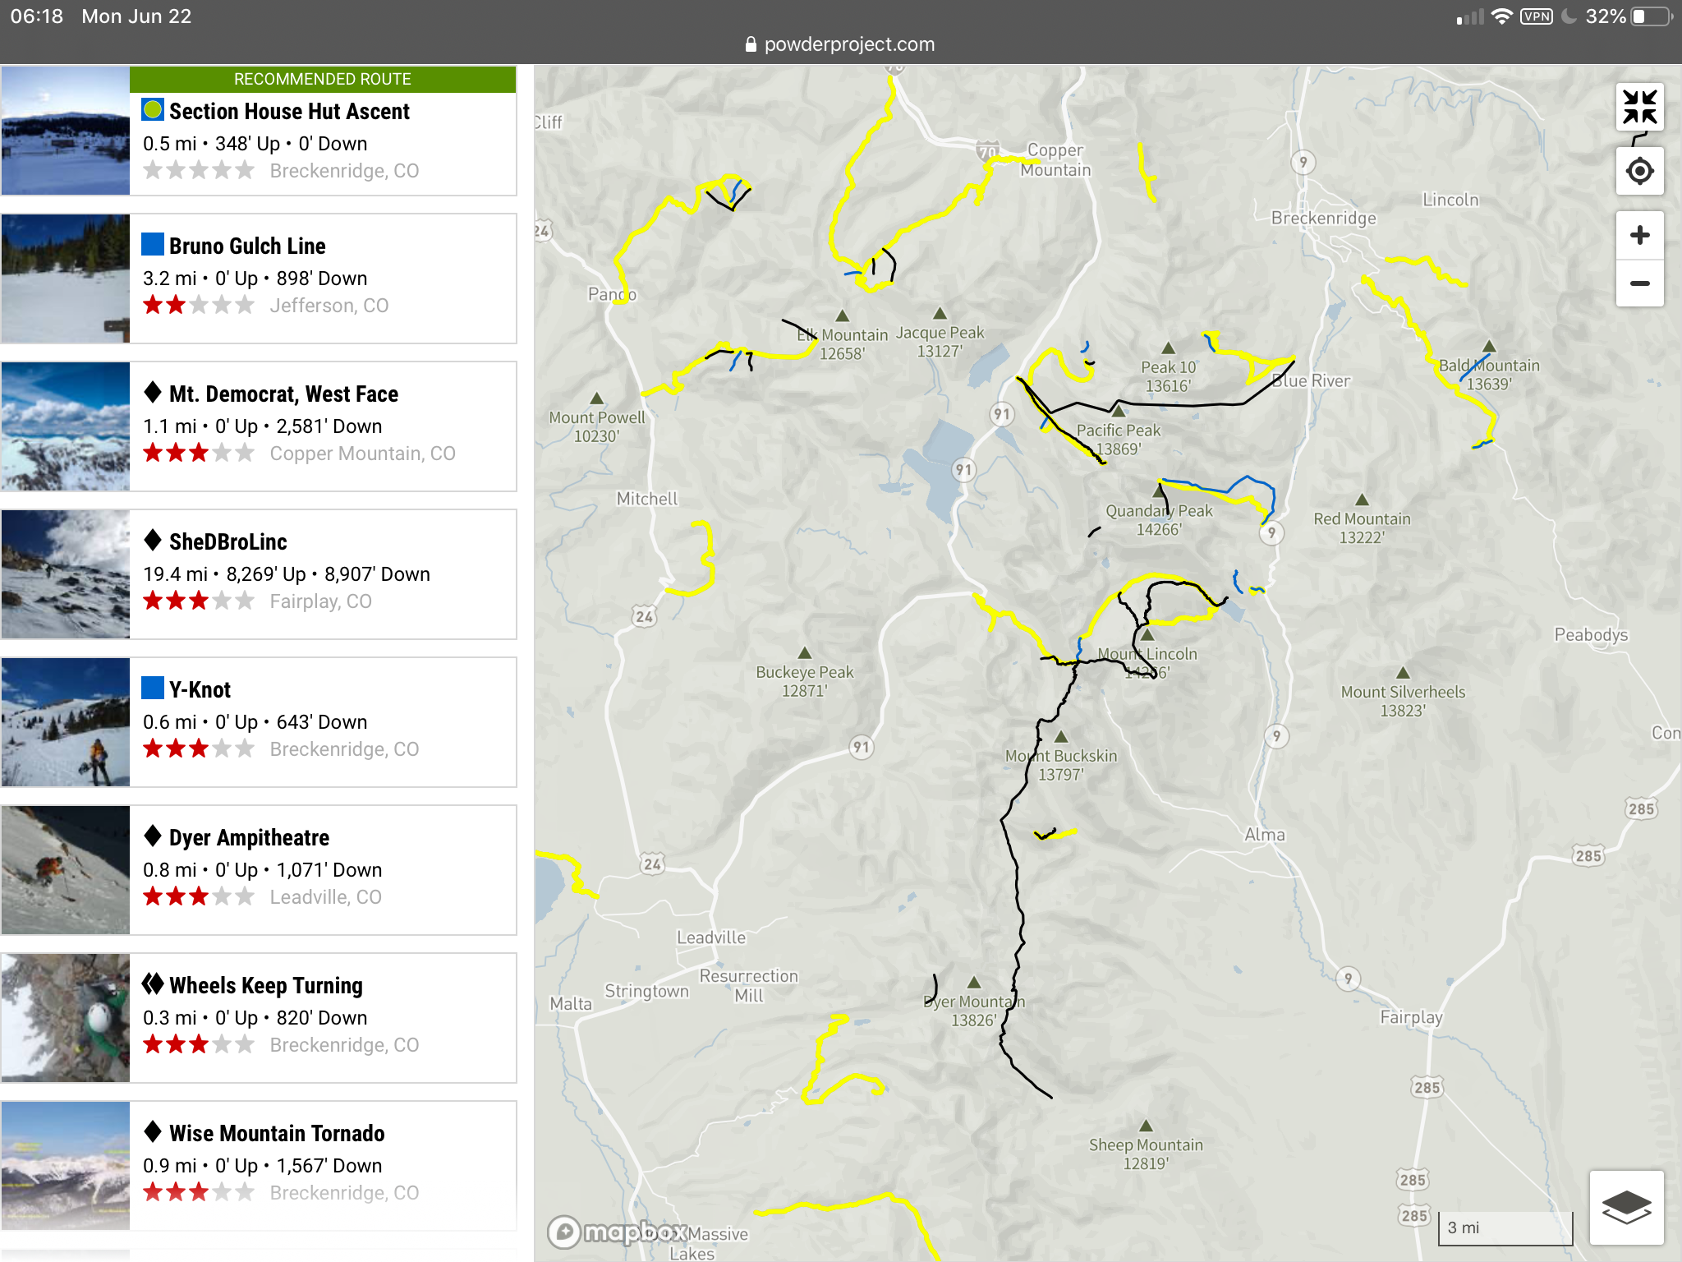


Slide 9
Final Product

Slide 10
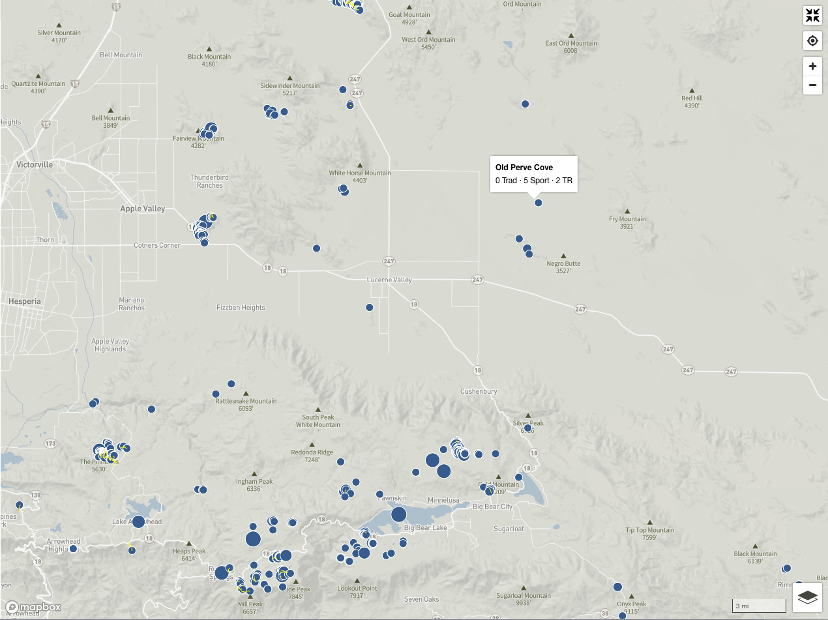

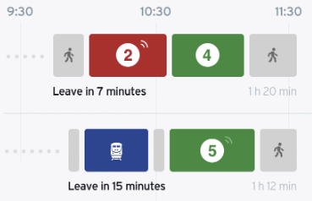
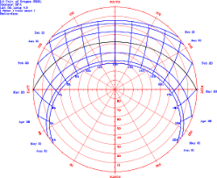
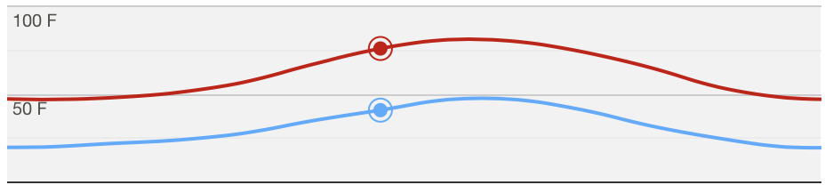
Layers
Adventure List
Hike Name
Waterfalls
Climb Name
Hikes
Climb Name
Basic Info
Planning: Time & Travel
Weather Trends/Forecast
Wind Direction
Direction

Slide 11
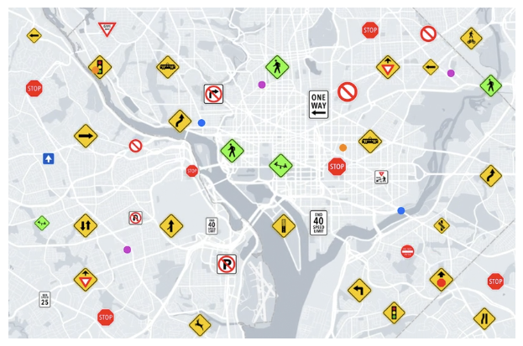

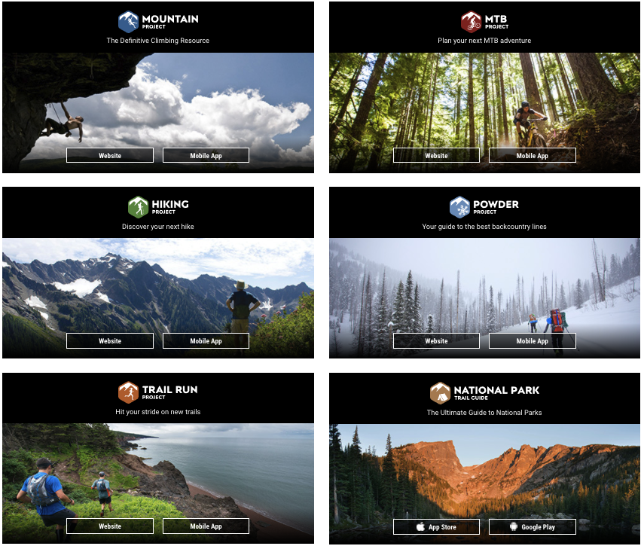
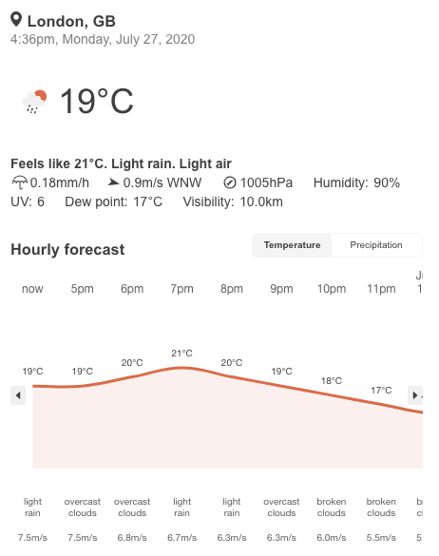
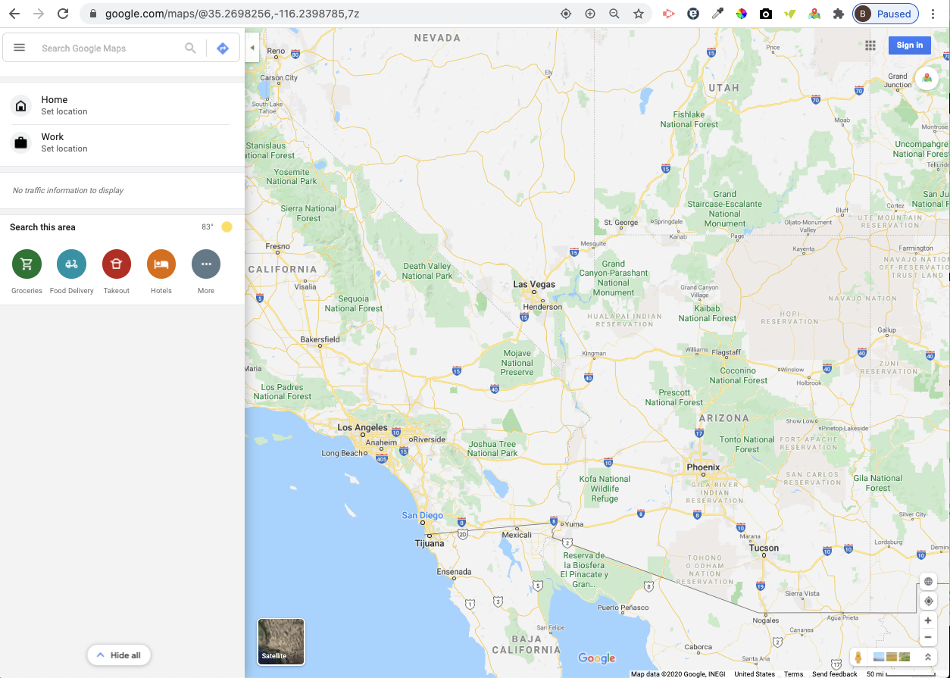
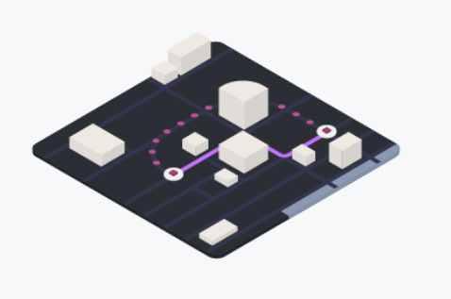
Transit API
APIs
Mapbox API
Google Maps & Routes API

Slide 12
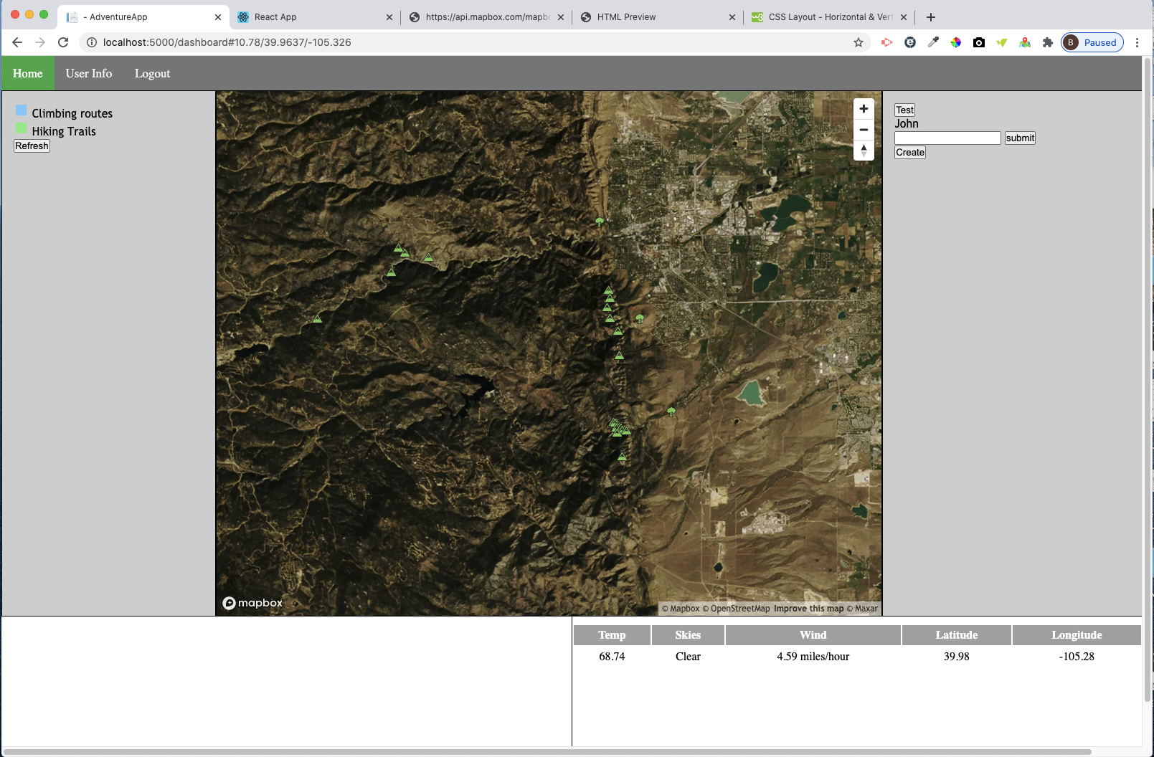
Current State
C# ASP NET Framework
APIs working:
Mountain Project
Hiking Project
Open Weather
MapBox
APIs needed:
Google Maps & Routes
Transit App
Outdoor APIs/Databases
Mountain Biking
Waterfalls
Hot Springs
Scenic Overlooks

Slide 13
Framework Goal
MERN Stack
Extras if needed

Slide 14
Development Needed: MERN Stack
Front Page
CSS
Pictures of Dashboard
Dashboard
CSS
JS hovers popups & windows
API interaction
Database & Backend Interaction
Edit Data Page: Needs to be developed
Allows user to select which apis to use
Google Maps vs Apple Maps
WeatherUnderground vs OpenWeather

